Slide 1
EclipseLink JPA: Queries and Object Building
Chris Delahunt

Slide 2
Topics
Query Execution: JPA and Native
Object Building
  Instantiation Policy and Clone Copy Policy
Cache Usage: Cache Hits & In-memory Querying
  Refreshing
Query Caching
Lazy Loading and Queries
Cursored Streams

Slide 3
EclipseLink Query Execution
EclipseLink
JDBC
SQL
Stored Procedure
Query
Framework
JP QL
Expressions
SQL
Query
Query By Example
Cache Hit?
Cache
Mappings
Application
Database
Cache Result?
Rows
Objects
Object
Builder

Slide 4
Primary Players By Package
org.eclipse.persistence.queries
  Queries
  Calls
  Policies: BatchFetch, InMemoryQueryIndirection,
  Cursored Stream
  Fetch Group
  Query Redirector
org.eclipse.persistence.internal.queries
  Container Policies
  Query Mechanisms
  ReportItem
  JoinedAttributeManager
org.eclipse.persistence.internal.dataaccess
  Database Calls

Slide 5
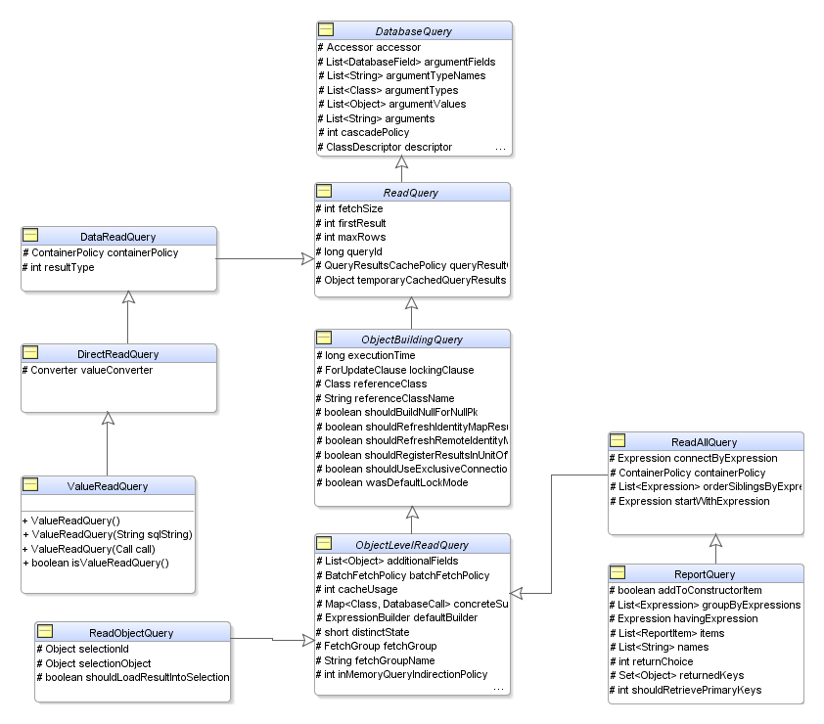
Native Read Queries

Slide 6
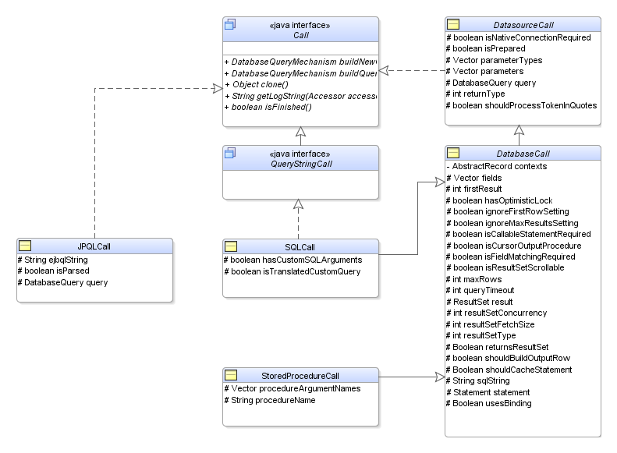
Calls

Slide 7
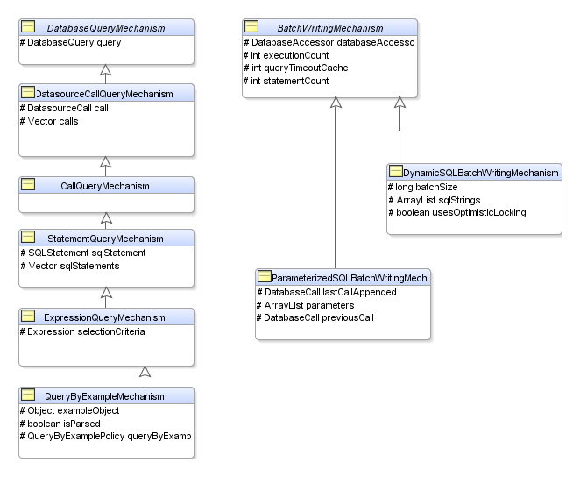
Query Mechanism

Slide 8
Key Components
Queries
  Native Queries
    ReadAllQuery, ReadObjectQuery, ReportQuery
    JpaQuery

Slide 9
Calls

Slide 10


Default Cache Behavior
Query
Framework
2. SQL Query
1. OO Query
3. Results
4. Does PK for row exist in cache?
5. NO: Build bean/object from results
Cache
6. Return object results
5. YES: Get from cache
Notes:
Default Cache Behavior
A typical scenario for reading regular Java objects:
Application invokes a query, which internally returns a result set (raw data) to TopLink.
Primary keys (PK) are extracted from the result set.
For each PK, IM is searched for matching object.
If found, then return the object in cache—identity maintained!
The object is not automatically refreshed with new data values.
If not found:
New object is built
New object is registered with IM
New object is returned to the application

Slide 11
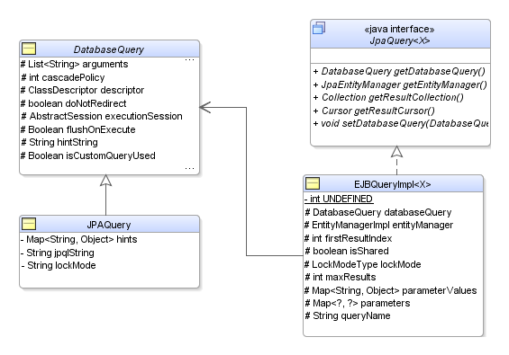
JPA Queries
Packages
  Org.eclispe.persistence.jpa
    JpaQuery
  Org.eclipse.persistence.internal.jpa
    JPAQuery
    EJBQueryImpl

Slide 12
JPA Query Classes

Slide 13
JPA Queries

